Slide 1
Machine Learning
Gradient Descent Algorithm
Linear Regression
Non-Linear Regression
Logistic Regression
Decision Trees
Regression Trees
Classification Trees
Model complexity and ensemble models
Clustering Algorithms
K-Means
Hierarchical clustering
DB-Scan
Mean Shift
GMM
Support Vector Machine
Datasets
Breast Cancer Wisconsin
MIMIC-III
Framingham Heart Study
Alzheimer’s Disease Neuroimaging Initiative
Drug discovery
Microbiome
Deep Learning
MLP
CNN
CNN Arquitectures
Autoencoders
E: Transfer learning y fine tunning
Recurrent Neural Networks
VAE
GAN
Transformers
Diffusion Models
Paper + Implementation

Slide 2
C9 – Intro to Deep Learning Multilayer Perceptron (MLP)
my humble ML course

Slide 3
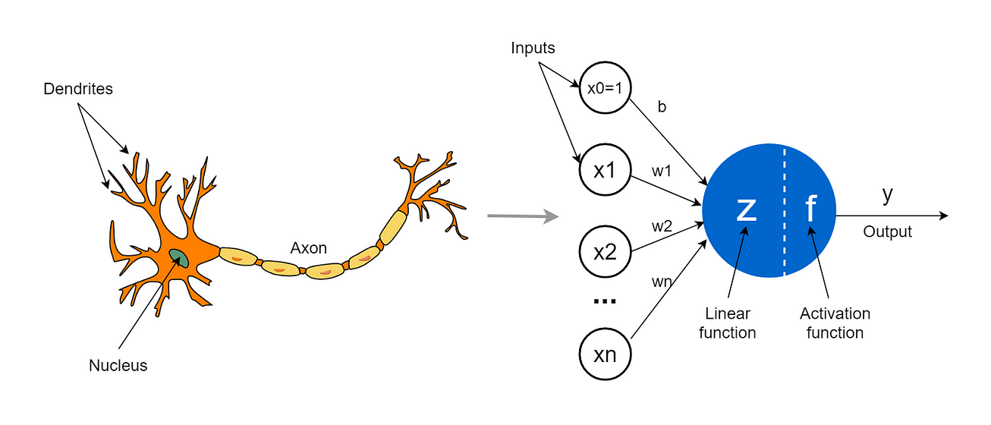
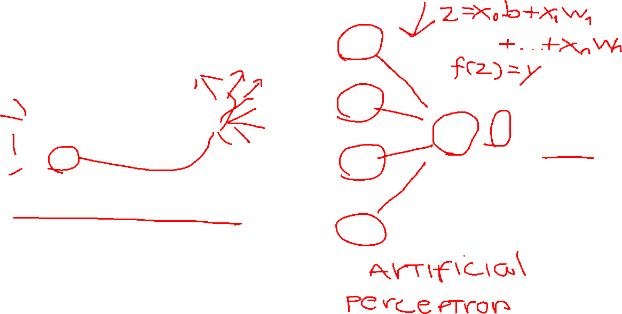
my humble ML course
Notes:
Artificial neurons (also called Perceptrons, Units or Nodes) are the simplest elements or building blocks in a neural network. They are inspired by biological neurons that are found in the human brain.
You can consider an artificial neuron as a mathematical model inspired by a biological neuron.
A biological neuron receives its input signals from other neurons through dendrites (small fibers). Likewise, a perceptron receives its data from other perceptrons through input neurons that take numbers.
The connection points between dendrites and biological neurons are called synapses. Likewise, the connections between inputs and perceptrons are called weights. They measure the importance level of each input.
In a biological neuron, the nucleus produces an output signal based on the signals provided by dendrites. Likewise, the nucleus (colored in blue) in a perceptron performs some calculations based on the input values and produces an output.
In a biological neuron, the output signal is carried away by the axon. Likewise, the axon in a perceptron is the output value which will be the input for the next perceptrons.

Slide 4

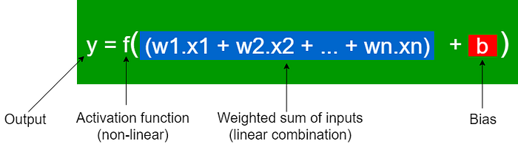
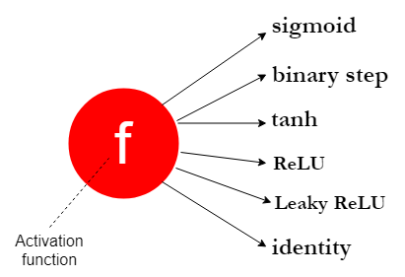
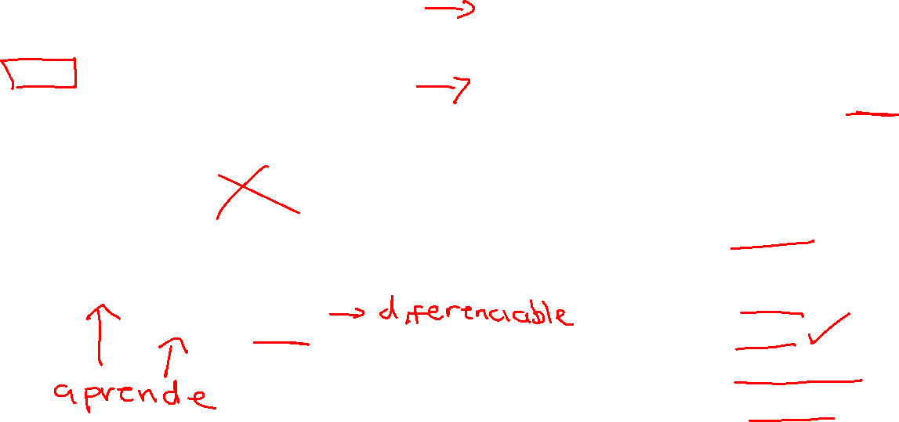
my humble ML course
Perceptron
Notes:
The weights and biases are called the parameters in a neural network model. The optimal values for those parameters are found during the learning (training) process of the neural network.
You can also think of the above z function as a linear regression model in which weights are known as coefficients and the bias term is known as the intercept. This is just the terminology used to identify the same thing in different contexts.
As there are many different types of activation functions, we’ll discuss them in detail in a separate article. For now, it is enough to remember that the purpose of an activation function is to introduce non-linearity to the network. Without an activation function, a neural network can only model linear relationships and can’t model non-linear relationships present in the data. Most of the relationships are non-linear in real-world data. Therefore, neural networks would be useless without activation functions.

Slide 5
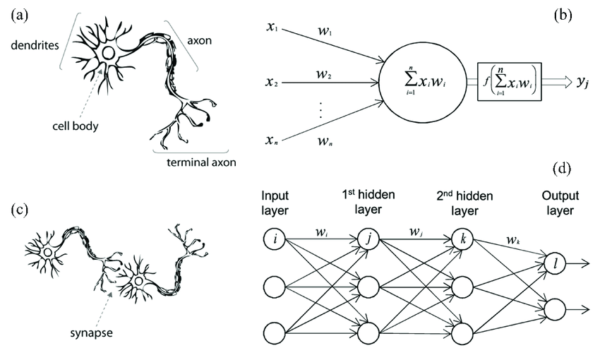
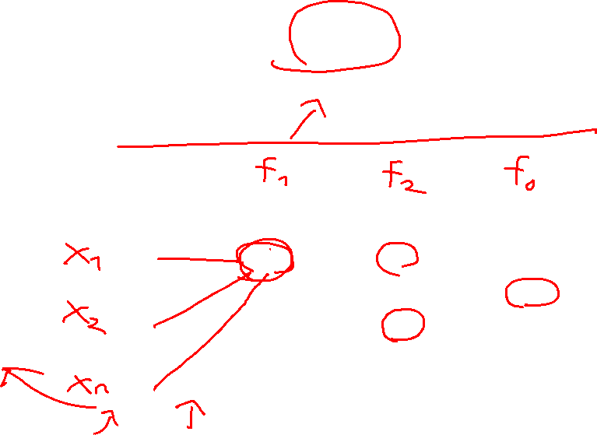
my humble ML course

Slide 6
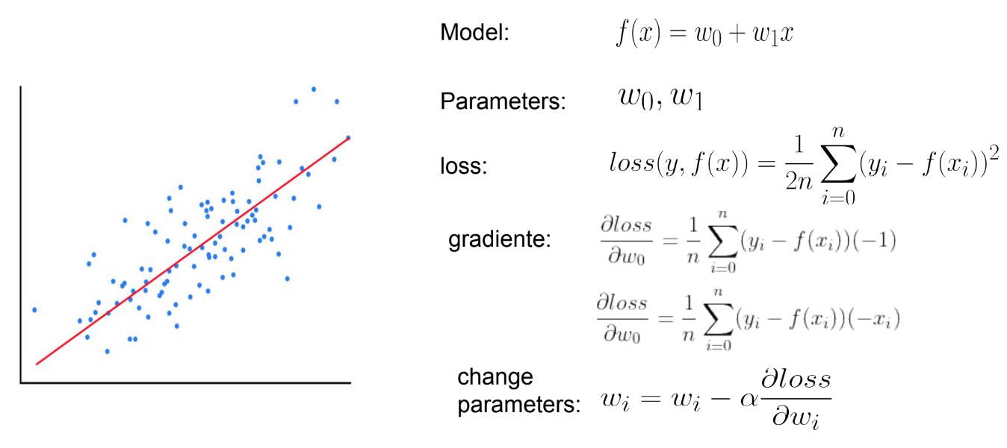
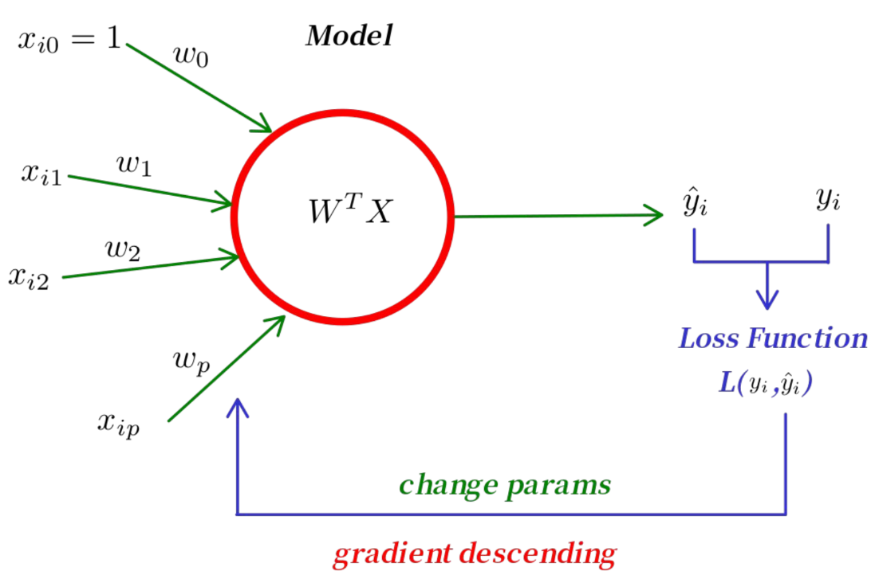
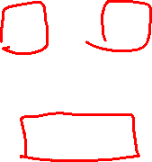
my humble ML course
Perceptron as a Linear Regression

Slide 7
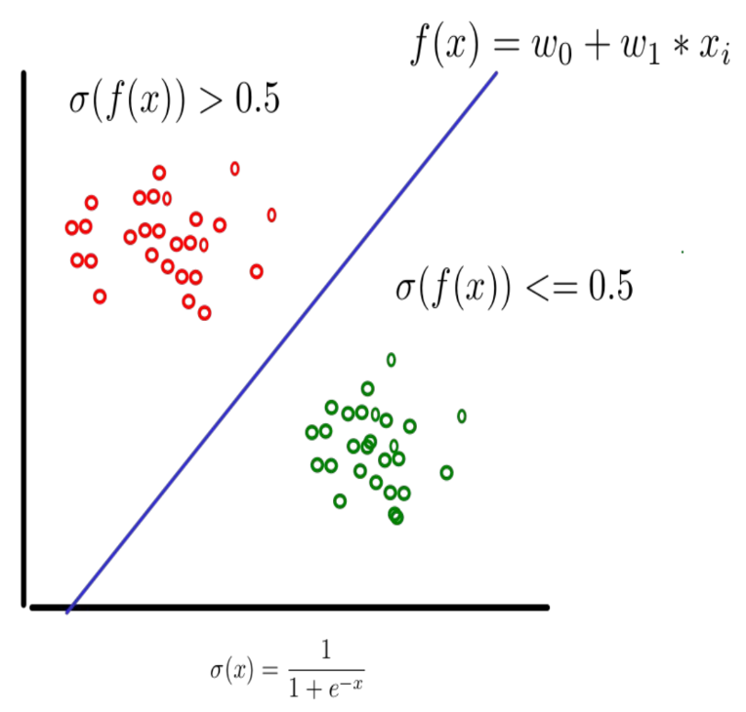
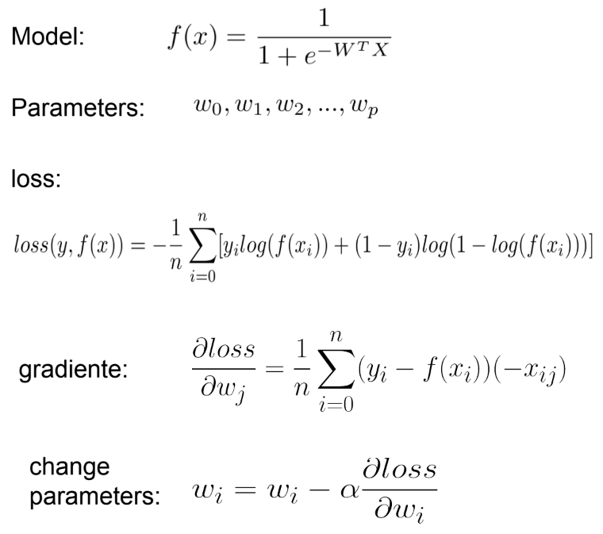
my humble ML course
Perceptron as a Logistic Regression

Slide 8
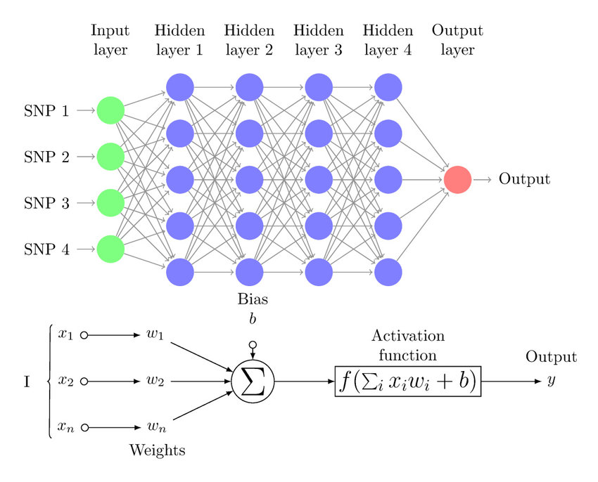
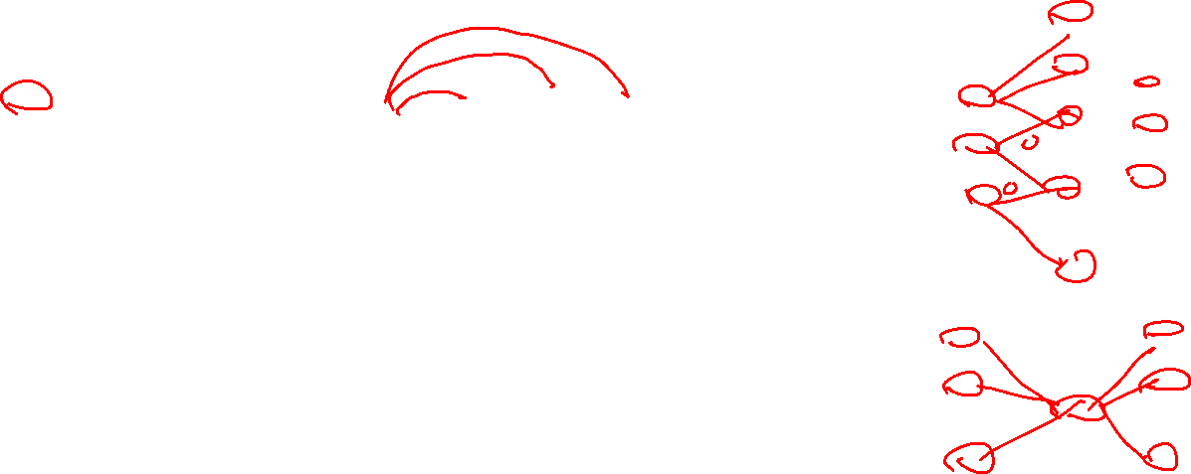
my humble ML course
Multilayer perceptron
Notes:
https://towardsdatascience.com/the-concept-of-artificial-neurons-perceptrons-in-neural-networks-fab22249cbfc

Slide 9
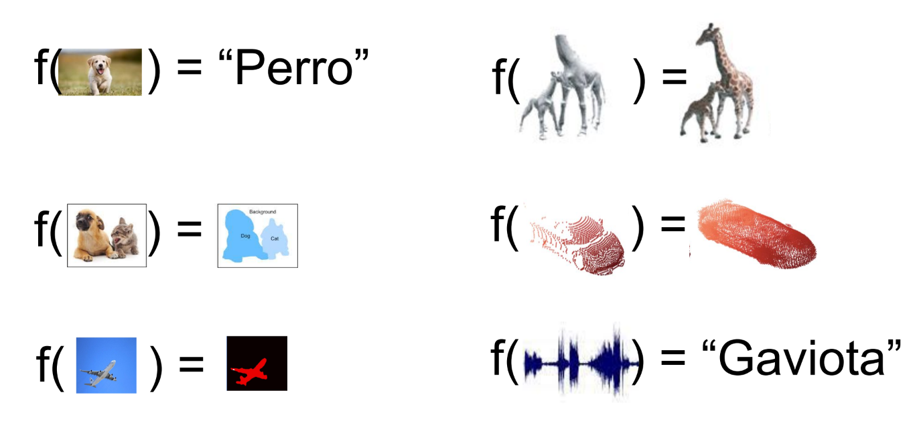
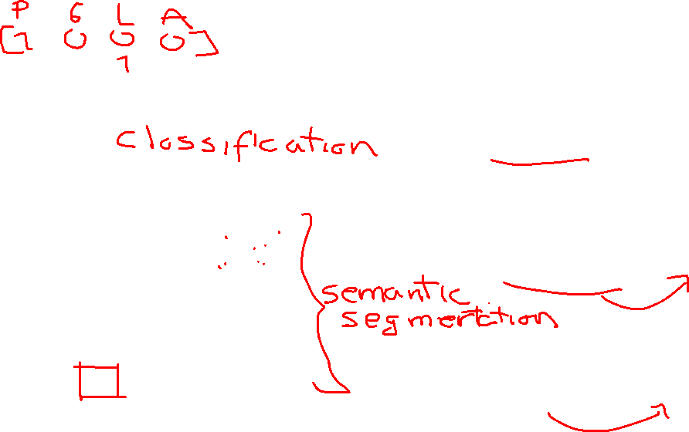
my humble ML course
Universal approximation theorem

Slide 10
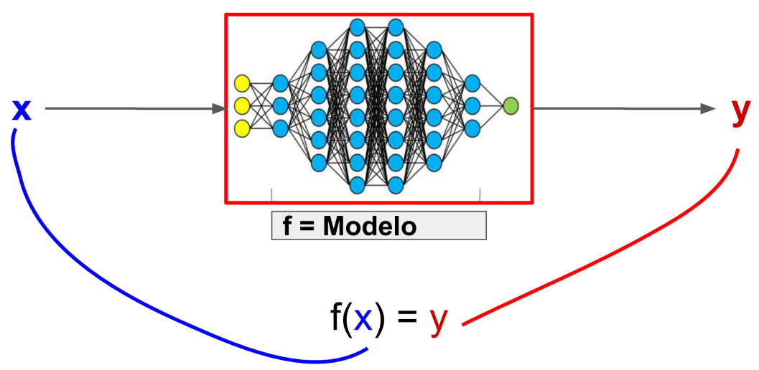
my humble ML course
MLP as a model

Slide 11
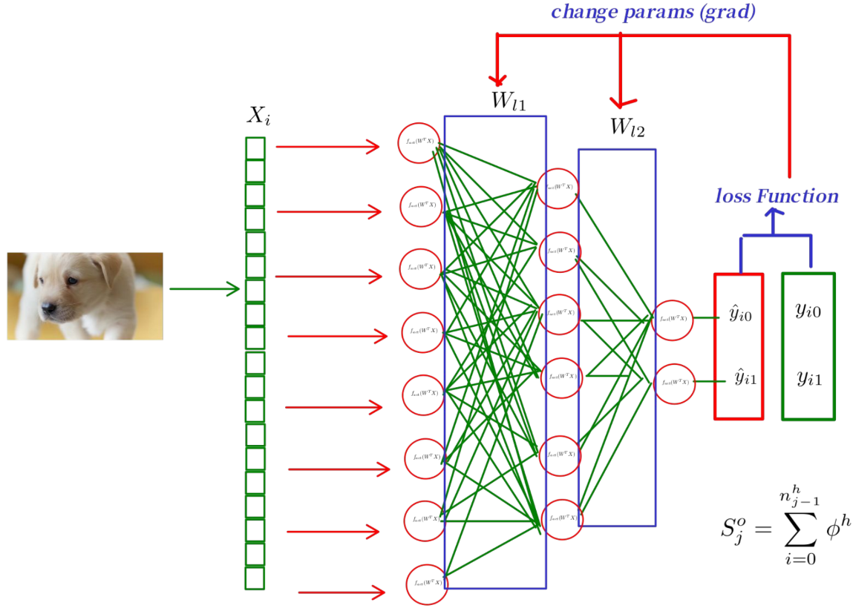
my humble ML course
MLP learning

Slide 12
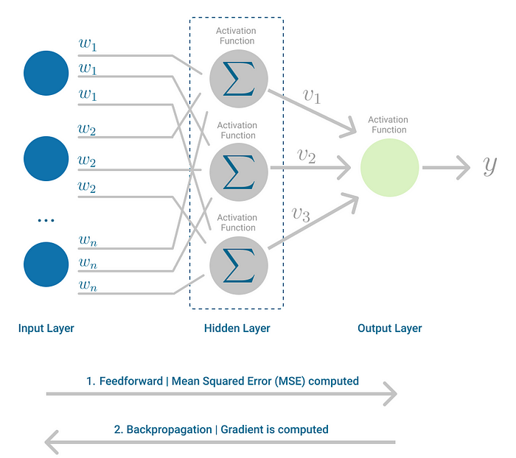
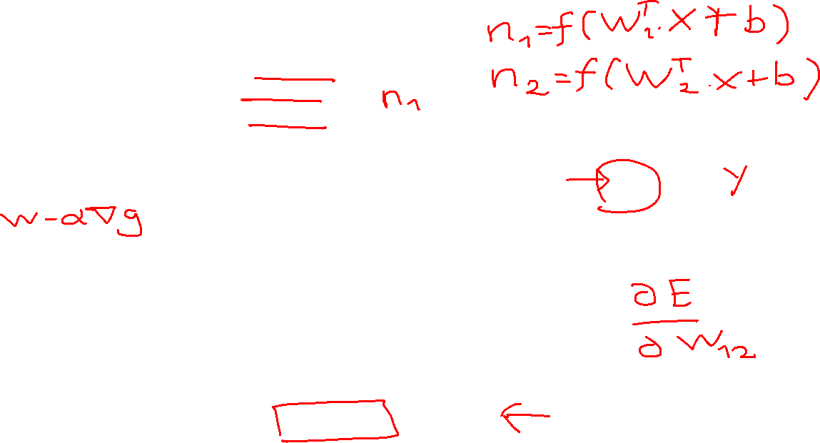
my humble ML course
MLP learning

Slide 13
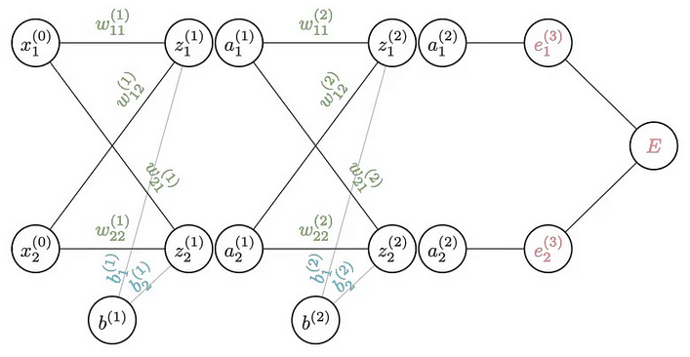
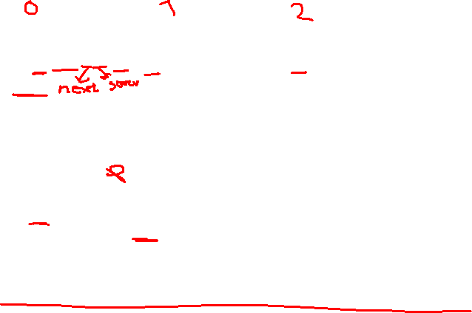
my humble ML course
Forward pass

Slide 14
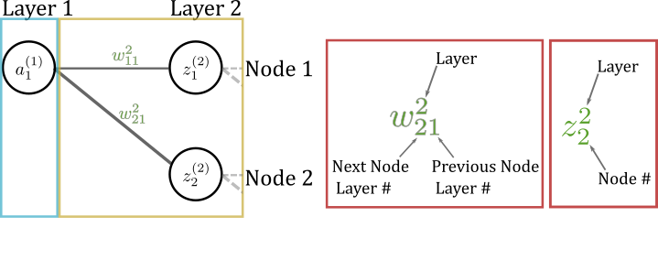
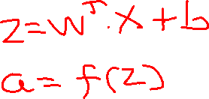
my humble ML course
Forward
pass

Slide 15
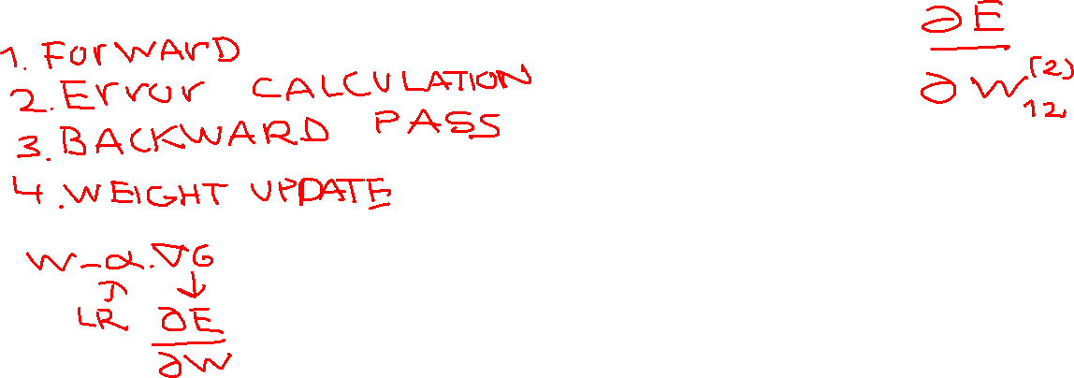
my humble ML course
Basics of Backpropagation
https://towardsdatascience.com/understanding-backpropagation-abcc509ca9d0
Notes:
https://towardsdatascience.com/understanding-backpropagation-abcc509ca9d0
Backpropagation, short for “backward propagation of errors,” was first introduced in the late 1970s as a mechanism for training neural networks. The early pioneers of neural network research, such as Geoffrey Hinton, David Rumelhart, and Ronald Williams, played a pivotal role in its development. The inspiration for backpropagation came from the biological concept of synaptic weight adjustment in the human brain. The idea was to build an artificial model that could mimic the learning process observed in biological neurons.
The Basics of Backpropagation
At its core, backpropagation is an optimization algorithm used to adjust the weights and biases of the artificial neurons within a neural network. This adjustment is guided by the goal of minimizing a predefined loss or error function. The steps of backpropagation can be summarized as follows:
Forward Pass: During the forward pass, input data is fed through the network, propagating it through the layers of neurons. Each neuron performs a weighted sum of its inputs, applies an activation function, and passes the result to the next layer.
Error Calculation: After the forward pass, the output of the neural network is compared to the ground truth, and the error or loss is computed. Common loss functions include Mean Squared Error (MSE) for regression tasks and Cross-Entropy for classification tasks.
Backward Pass: The key step in backpropagation is the backward pass, where the gradients of the error with respect to the network’s weights and biases are computed. This is achieved through the chain rule of calculus, which allows the error to be propagated backward through the network.
Weight Update: Once the gradients are known, the weights and biases of the network are updated using optimization techniques like gradient descent. The goal is to adjust these parameters in a way that reduces the error, thus improving the network’s performance.
Backpropagation
Backpropagation is the learning mechanism that allows the Multilayer Perceptron to iteratively adjust the weights in the network, with the goal of minimizing the cost function.

Slide 16
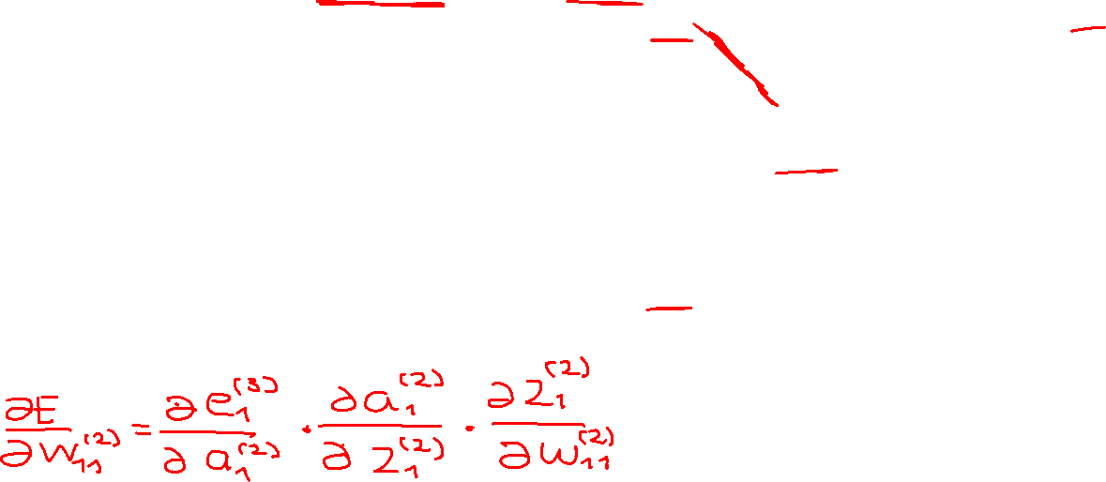
my humble ML course
Notes:
https://towardsdatascience.com/understanding-backpropagation-abcc509ca9d0
Backpropagation, short for “backward propagation of errors,” was first introduced in the late 1970s as a mechanism for training neural networks. The early pioneers of neural network research, such as Geoffrey Hinton, David Rumelhart, and Ronald Williams, played a pivotal role in its development. The inspiration for backpropagation came from the biological concept of synaptic weight adjustment in the human brain. The idea was to build an artificial model that could mimic the learning process observed in biological neurons.
The Basics of Backpropagation
At its core, backpropagation is an optimization algorithm used to adjust the weights and biases of the artificial neurons within a neural network. This adjustment is guided by the goal of minimizing a predefined loss or error function. The steps of backpropagation can be summarized as follows:
Forward Pass: During the forward pass, input data is fed through the network, propagating it through the layers of neurons. Each neuron performs a weighted sum of its inputs, applies an activation function, and passes the result to the next layer.
Error Calculation: After the forward pass, the output of the neural network is compared to the ground truth, and the error or loss is computed. Common loss functions include Mean Squared Error (MSE) for regression tasks and Cross-Entropy for classification tasks.
Backward Pass: The key step in backpropagation is the backward pass, where the gradients of the error with respect to the network’s weights and biases are computed. This is achieved through the chain rule of calculus, which allows the error to be propagated backward through the network.
Weight Update: Once the gradients are known, the weights and biases of the network are updated using optimization techniques like gradient descent. The goal is to adjust these parameters in a way that reduces the error, thus improving the network’s performance.
Backpropagation
Backpropagation is the learning mechanism that allows the Multilayer Perceptron to iteratively adjust the weights in the network, with the goal of minimizing the cost function.

Slide 17
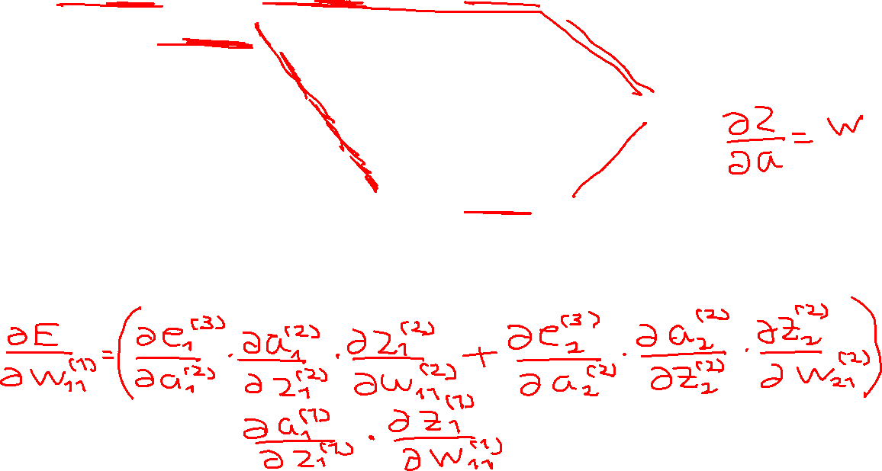
my humble ML course
Notes:
https://towardsdatascience.com/understanding-backpropagation-abcc509ca9d0
Backpropagation, short for “backward propagation of errors,” was first introduced in the late 1970s as a mechanism for training neural networks. The early pioneers of neural network research, such as Geoffrey Hinton, David Rumelhart, and Ronald Williams, played a pivotal role in its development. The inspiration for backpropagation came from the biological concept of synaptic weight adjustment in the human brain. The idea was to build an artificial model that could mimic the learning process observed in biological neurons.
The Basics of Backpropagation
At its core, backpropagation is an optimization algorithm used to adjust the weights and biases of the artificial neurons within a neural network. This adjustment is guided by the goal of minimizing a predefined loss or error function. The steps of backpropagation can be summarized as follows:
Forward Pass: During the forward pass, input data is fed through the network, propagating it through the layers of neurons. Each neuron performs a weighted sum of its inputs, applies an activation function, and passes the result to the next layer.
Error Calculation: After the forward pass, the output of the neural network is compared to the ground truth, and the error or loss is computed. Common loss functions include Mean Squared Error (MSE) for regression tasks and Cross-Entropy for classification tasks.
Backward Pass: The key step in backpropagation is the backward pass, where the gradients of the error with respect to the network’s weights and biases are computed. This is achieved through the chain rule of calculus, which allows the error to be propagated backward through the network.
Weight Update: Once the gradients are known, the weights and biases of the network are updated using optimization techniques like gradient descent. The goal is to adjust these parameters in a way that reduces the error, thus improving the network’s performance.
Backpropagation
Backpropagation is the learning mechanism that allows the Multilayer Perceptron to iteratively adjust the weights in the network, with the goal of minimizing the cost function.

Slide 18
my humble ML course
Bibliography
https://towardsdatascience.com/pytorch-introduction-building-your-first-linear-model-d868a8681a41
https://medium.com/@mohamedyosef101/understanding-neural-networks-by-building-one-from-scratch-using-numpy-61500b9ca882
https://medium.com/@evertongomede/understanding-backpropagation-the-engine-behind-neural-network-learning-a7c2e1acdbf
https://towardsdatascience.com/multilayer-perceptron-explained-with-a-real-life-example-and-python-code-sentiment-analysis-cb408ee93141
https://medium.com/@rukshanpramoditha/list/neural-networks-and-deep-learning-course-a2779b9c3f75
https://towardsdatascience.com/understanding-backpropagation-abcc509ca9d0
https://youtube.com/playlist?list=PLZHQObOWTQDNU6R1_67000Dx_ZCJB-3pi&si=9LsJ8HjltbuLtFqs
https://towardsdatascience.com/understanding-backpropagation-algorithm-7bb3aa2f95fd
Notes:
https://levelup.gitconnected.com/10-python-libraries-for-automated-machine-learning-that-you-should-think-to-use-in-2023-730a2694f221
https://medium.com/search?q=backpropagation

Slide 19
C9 – Gradient Optimizers
my humble ML course

Slide 20
my humble ML course
Bibliography
https://www.analyticsvidhya.com/blog/2021/06/complete-guide-to-gradient-based-optimizers/
https://www.analyticsvidhya.com/blog/2021/10/a-comprehensive-guide-on-deep-learning-optimizers/
https://www.ruder.io/optimizing-gradient-descent/
https://arxiv.org/pdf/1609.04747.pdf
https://medium.com/@nerdjock
https://medium.com/analytics-vidhya/optimizers-gradient-descent-algorithms-part-1-ac9baf446df1
https://naokishibuya.medium.com/gradient-descent-optimizers-80d29f22deb5
https://towardsdatascience.com/effect-of-gradient-descent-optimizers-on-neural-net-training-d44678d27060
https://towardsdatascience.com/neural-network-optimizers-made-simple-core-algorithms-and-why-they-are-needed-7fd072cd2788
https://iq.opengenus.org/types-of-gradient-optimizers/
https://medium.com/@dancerworld60/optimizers-part-1-gradient-descent-and-its-variants-d11dac1d6b2
https://towardsdatascience.com/optimizers-for-training-neural-network-59450d71caf6
Notes:
https://levelup.gitconnected.com/10-python-libraries-for-automated-machine-learning-that-you-should-think-to-use-in-2023-730a2694f221
https://medium.com/search?q=backpropagation

